Slide 1







INTRODUCTION TO
GIT & GITHUB
Presented by: Rashmi Mohan (IT 74)
Sahil Sangtani (IT 78)
Satyam Agrawal (IT 81)
Guided by: Lalit Purohit Sir
Upendra Singh Sir

Slide 2







Slide 3







Overview
What is Version Control System ? About Git & GitHub
Difference between Git & GitHub Setting up Git
Configure Git
Account Creation of GitHub Branching, Forking , Merging Basic commands of Git Upload Project on GitHub

Slide 4


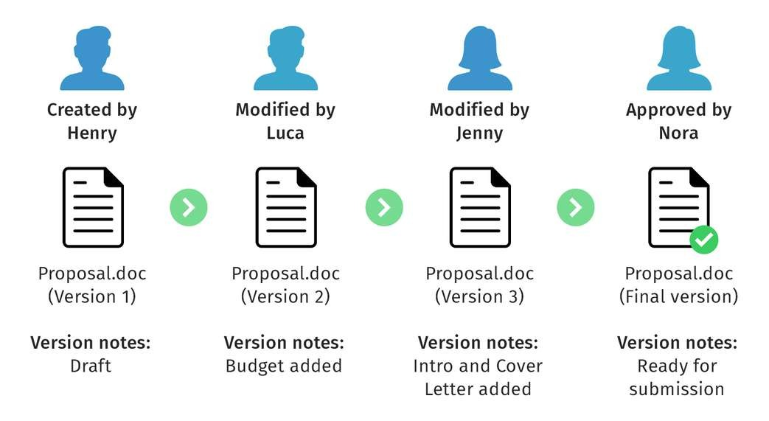


What is Version Control System ?
A version control system (VCS) is a software tool that tracks changes to files and code over time, allowing multiple users to collaborate on a project efficiently. It records modifications, provides a history of changes, facilitates branching and merging, and enables reverting to previous versions. This ensures a structured and organized approach to development, enhancing collaboration, and preserving a reliable project history.

Slide 5


Types of Version Control System
There three types of Version Control System :
Local Version Control System
Centralized Version Control System Distributed Version Control System

Slide 6

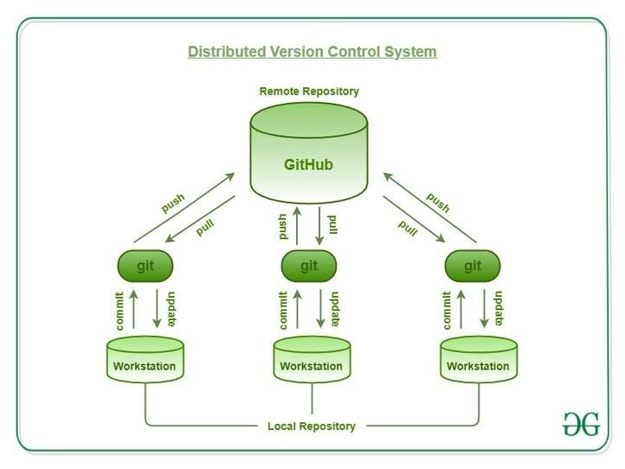

Distributed Version Control System:
A Distributed Version Control System (DVCS) is a software tool that allows multiple users to work on a project collaboratively, maintaining their own complete copies of the project's history. It facilitates efficient branching, merging, and offline access, enhancing collaboration. Popular in software development, Git, a leading DVCS, enables developers to work concurrently and manage project versions effectively, providing speed and versatility to the development process.

Slide 7

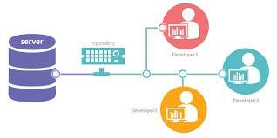

Git:
Git is a version control system that is used for tracking changes in computer files and coordinating work on those files among multiple people. It is a distributed version control system, which means that it allows multiple users to work on the same files simultaneously and keeps track of changes made to the files by each user. Git is widely used in software development and has become a standard tool for collaborating on code.

Slide 8




Characteristics of Git:
Distributed Version Control :
Git is a distributed version control system, allowing multiple users to work on a project simultaneously.
Snapshot-based:
Git records the entire project at different points in time as snapshots, making it efficient and providing a complete version history.
Branching and Merging:
Git enables easy branching to work on different features or changes independently and allows seamless merging of branches.
Local Operations:
Most Git operations are performed locally, making it fast and efficient, without requiring a constant connection to a central server.

Slide 9


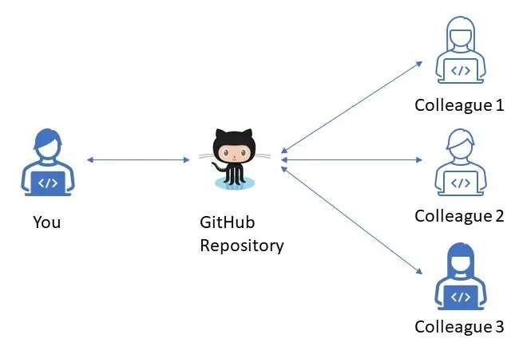

GitHub:
GitHub is a web-based platform that serves as a hub for developers to collaborate on projects using Git. It provides a centralized location for storing, managing, and sharing code. Users can create repositories to host their projects, track changes through Git version control, and facilitate collaboration by allowing multiple contributors to work on the same codebase. GitHub offers features like issue tracking, pull requests, and discussions, making it a powerful tool for team-based software development and open-source projects.

Slide 10

Difference
Git
Distributed version control system. Operates on a developer's machine. Manages code versions locally.
No internet dependency. No collaboration features Command-line tool.
GitHub
Web-based platform.
Hosts repositories in the cloud. Provides project management features. Requires internet access for usage.
Facilitates remote collaboration. Provides a graphical interface.

Slide 11





P R O P O S A L
ACCE P T E D

Slide 12




Creating account on GitHub:
1. Open your web browser and go to the GitHub website at https://github.com.

Slide 13

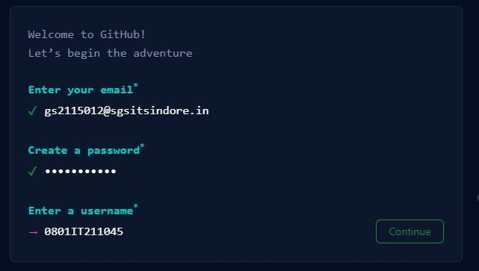



2. On the GitHub homepage, you'll see a "Sign up" form. Enter your desired email address and password.

Slide 14

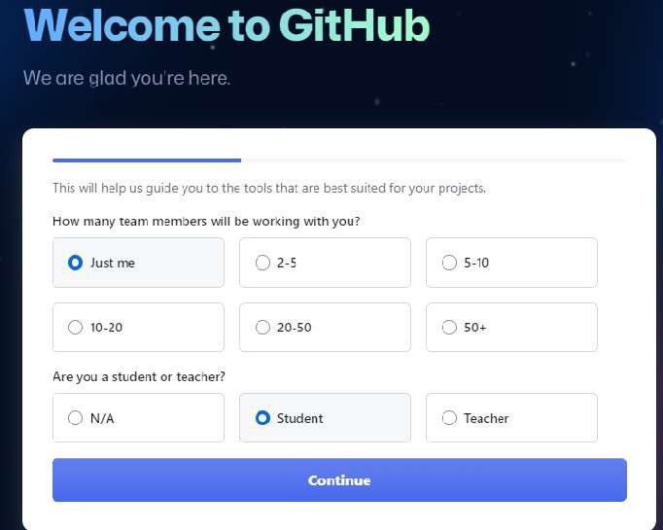


GitHub will send a verification email to the email address you provided. Go to your email inbox, open the email from GitHub, and follow the instructions to verify your email.
You'll be prompted to complete the sign-up process. Optionally, you can:
Customize your experience by selecting your interests. Choose to receive updates and newsletters from GitHub.
5. Acount creation is completed, personalize your account as per your needs.

Slide 15

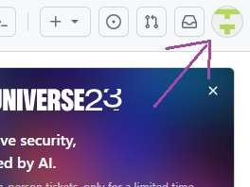
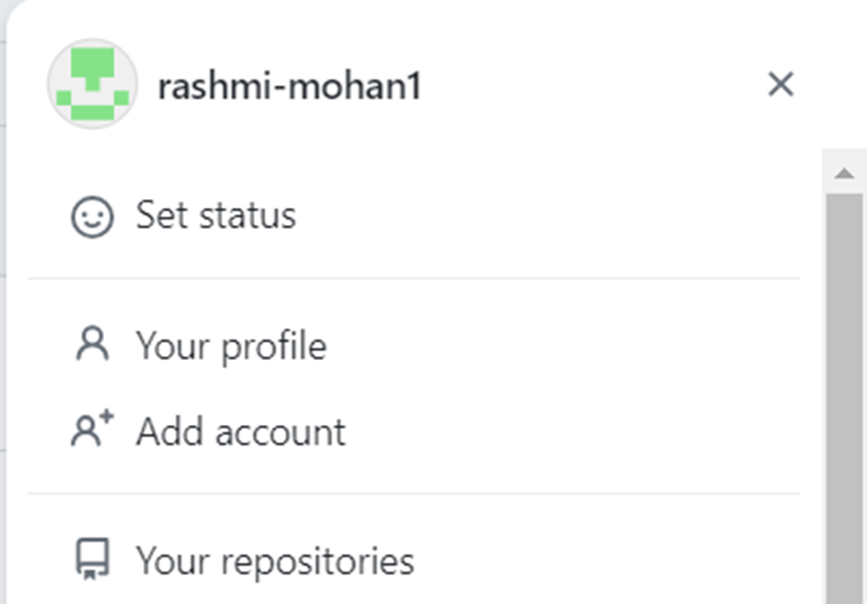
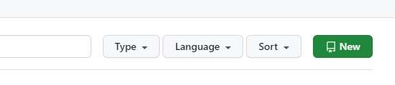


Creating New Repository in GitHub:
Login to your GitHub and Click on the top right corner icon.
From the appeared dropdown list select “Your Repositories".
3. Now select “New” button

Slide 16


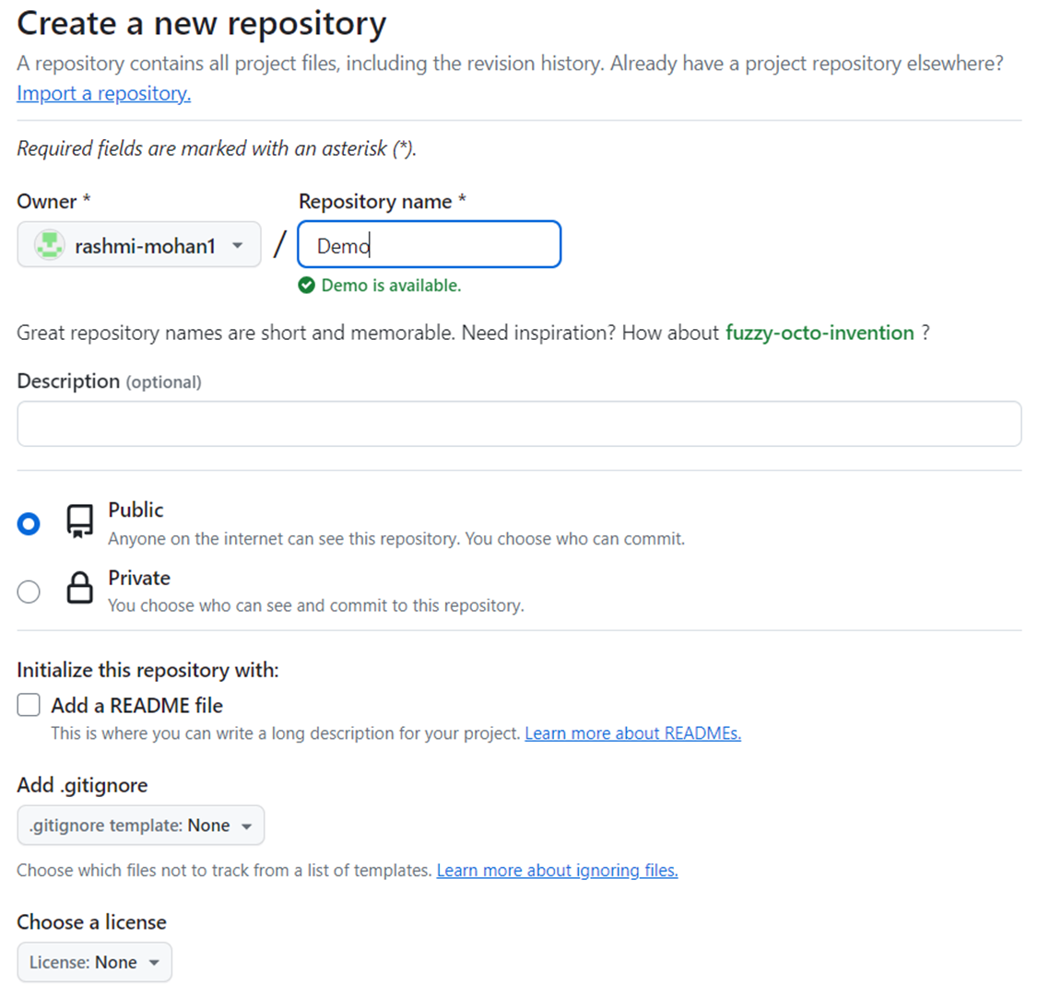

4. A new form will appear, type all the required details of the new repository in the form and click on “Create Repository” Button. Then the new repository will be created on GitHub.

Slide 17
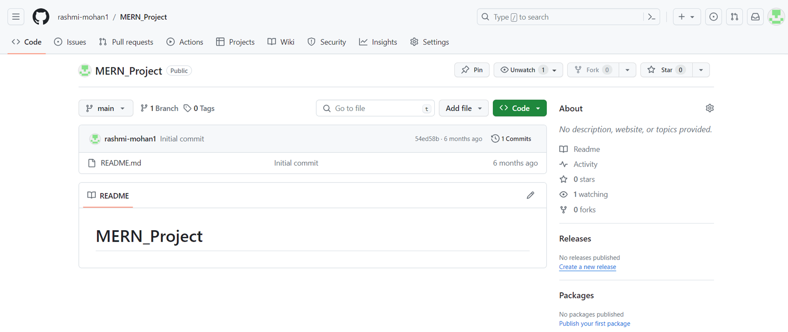
5. Newly created Repository will appear like this :

Slide 18
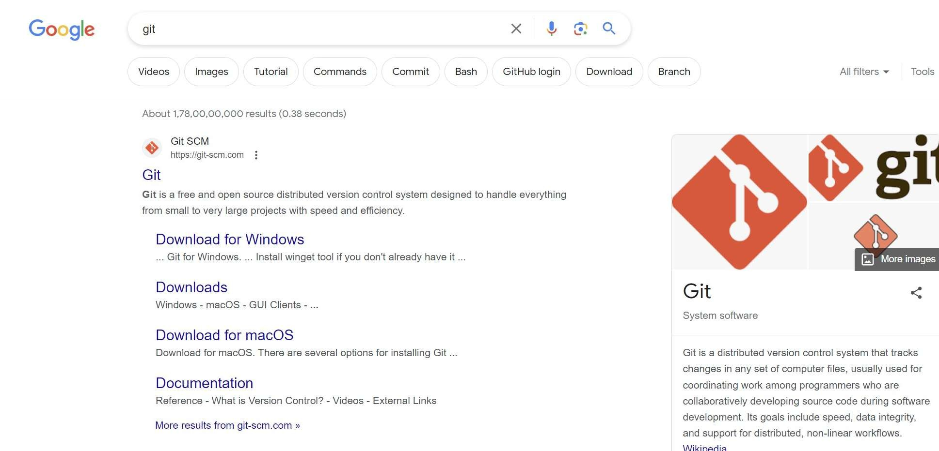

Setting Up Git:
1. Type git in your web browser’s search bar.

Slide 19


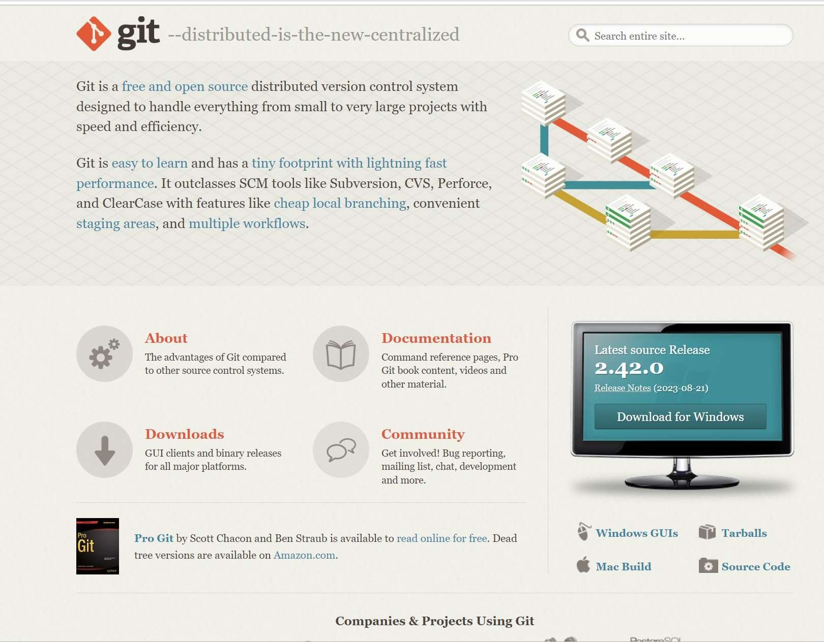
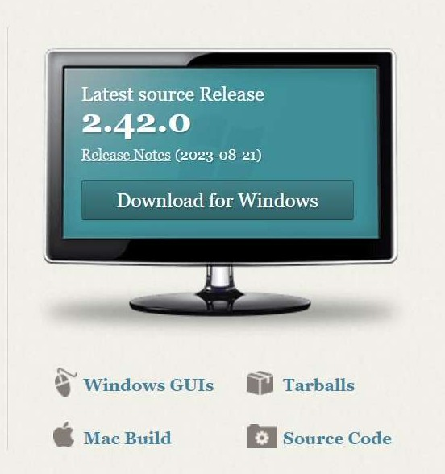
2. If you’re a windows user click download for windows, else click on mac build.

Slide 20
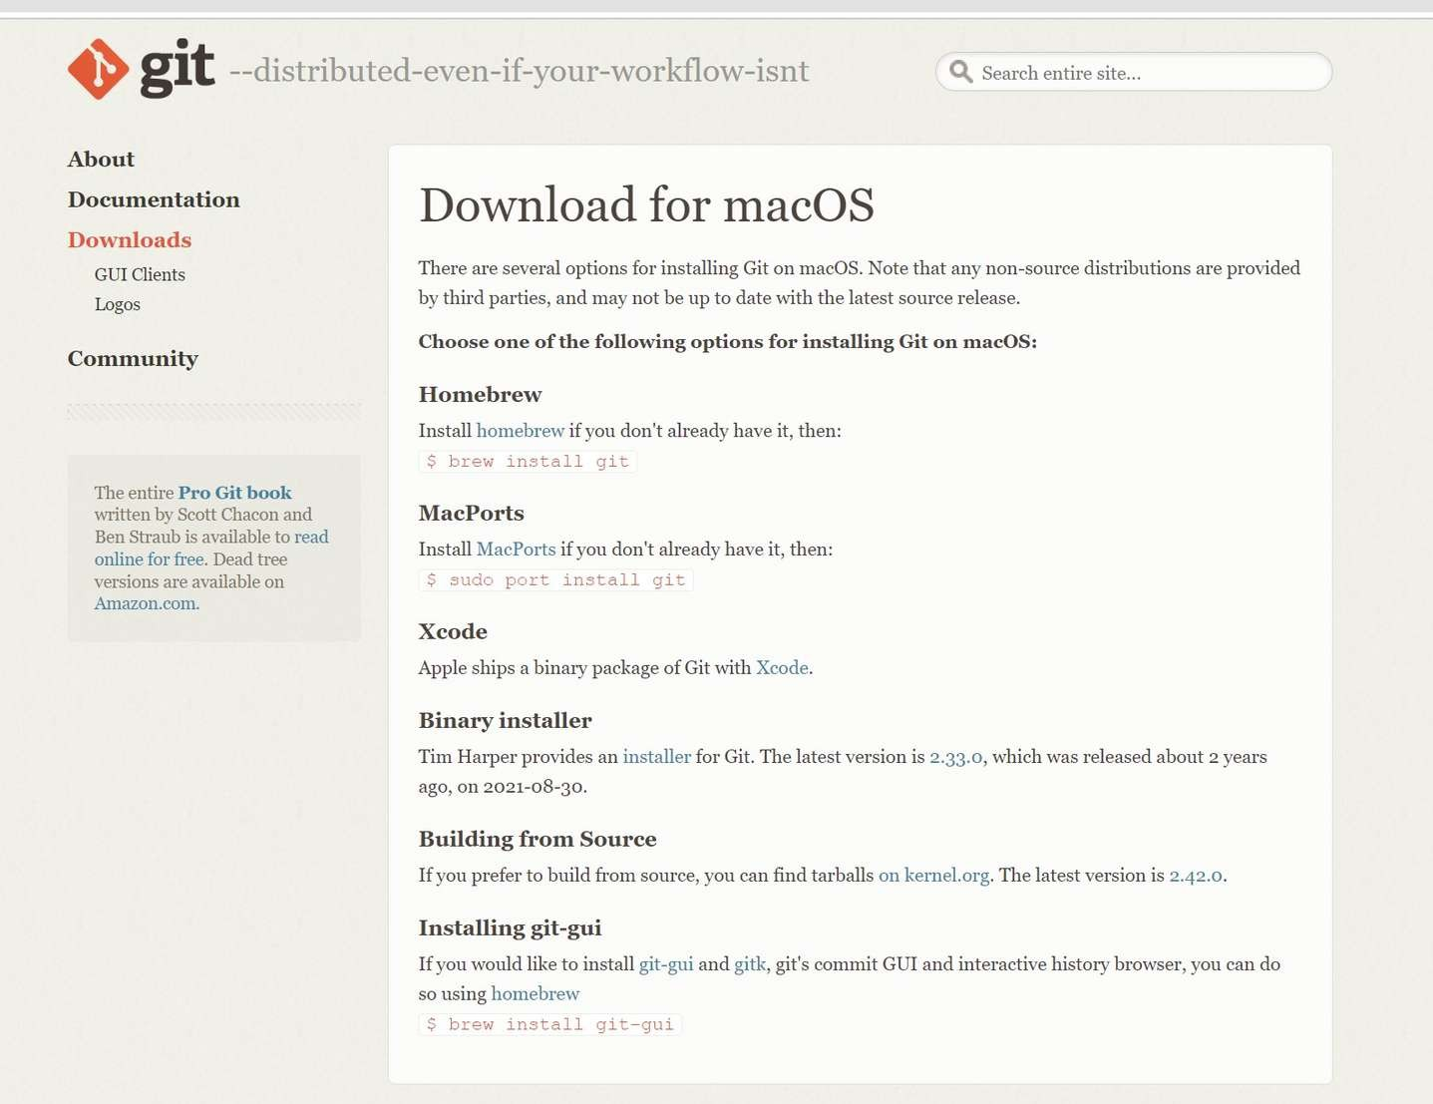
3. Mac users should follow the given procedure:

Slide 21
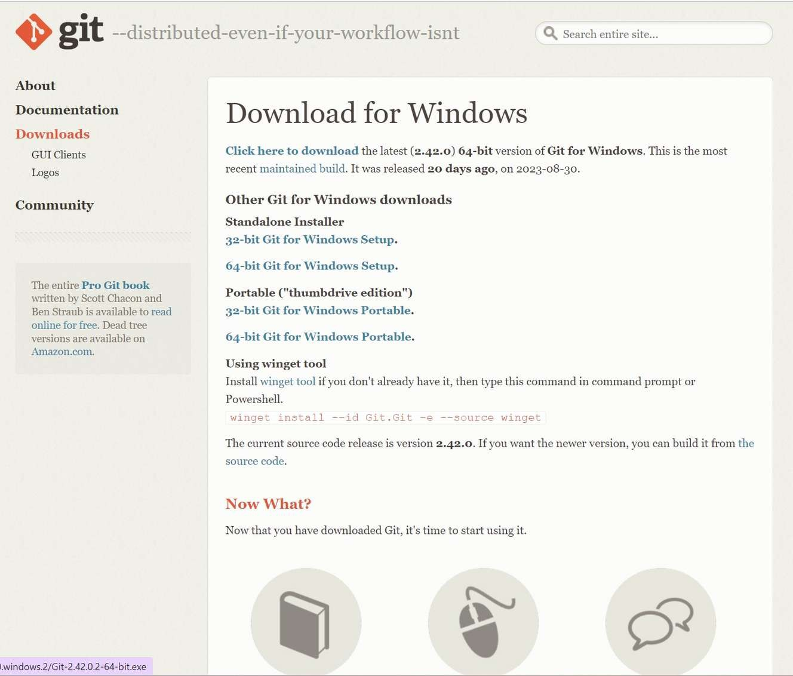

4. Click on click here to download.

Slide 22
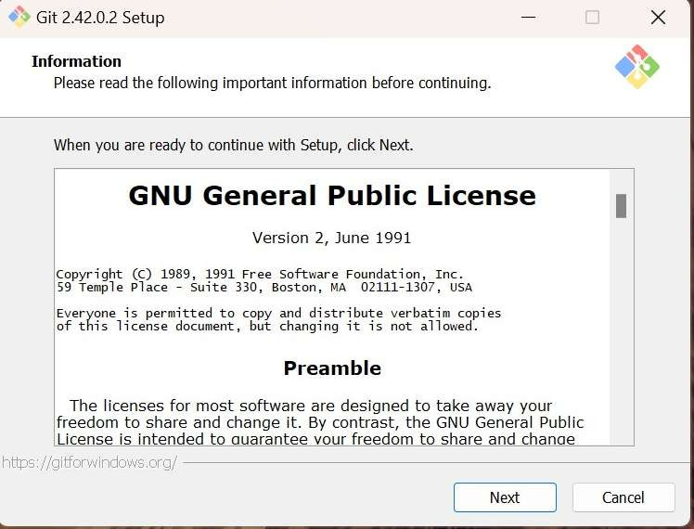

5. After the download is complete, open the downloaded file and the following setup dialog box will appear.

Slide 23


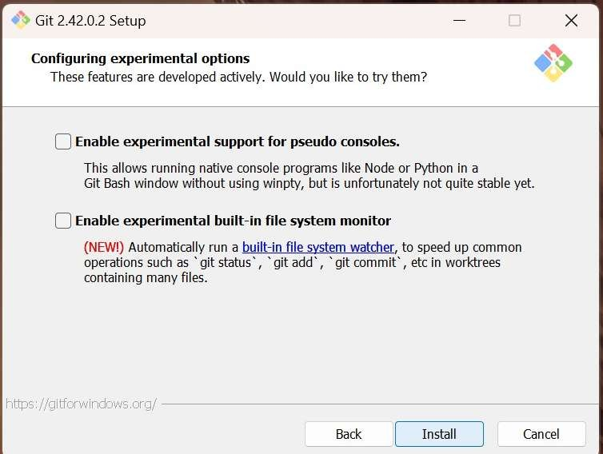
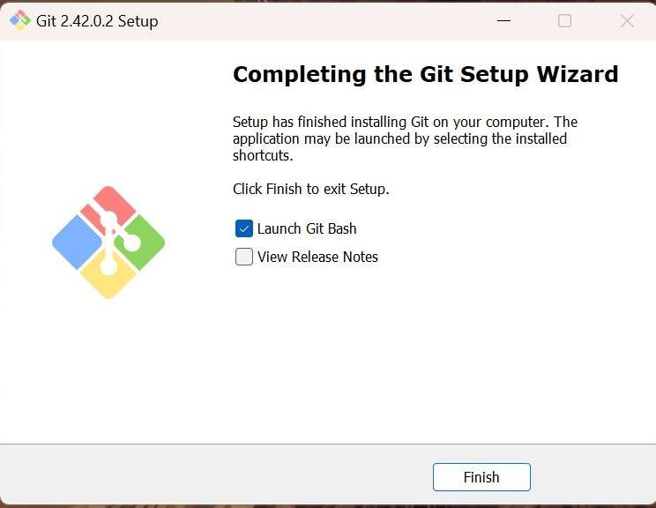
6. Keep clicking “next” until the following dialog box appears. Now click ”install” and git would be installed. Clicking finish would launch Git Bash.

Slide 24
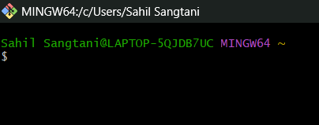
7. This is how the git bash looks like.

Slide 25





What is Git Bash and why are we using ?
Git Bash is a Windows application that emulates a Linux-like command line interface, enabling Git usage. It installs Bash, common utilities, and Git, providing a familiar environment for Windows users to work with Git as it resembles Linux and macOS terminal experiences.

Slide 26
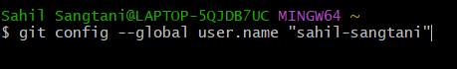
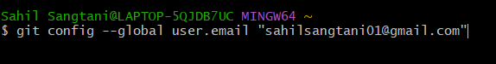
Configure Git:
git config command is used for configuring our username and email address. So for configuration, we can type the following command:

Slide 27
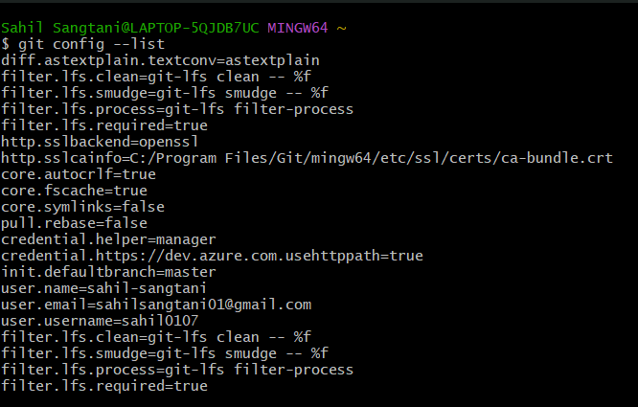
Configure Git:
git config --list Command. (To verify configured username and email)

Slide 28

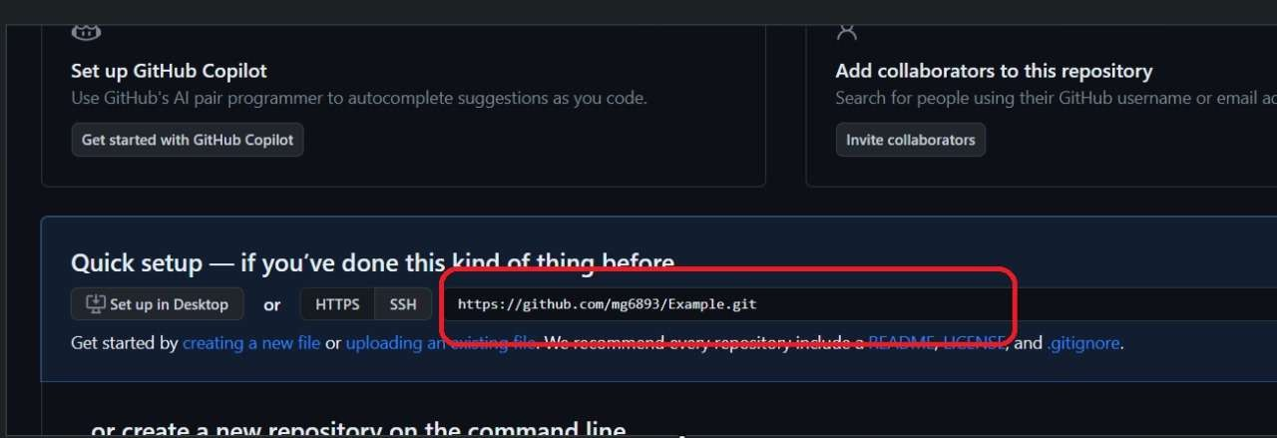

Basic Commands: Clone
"Clone" in GitHub means making a copy of a repository from the remote server to your local computer for editing.
syntax: git clone <link>

Slide 29
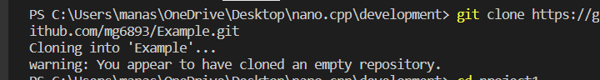


Slide 30
Git Status
“git status” is a Git command that displays the current state of your local Git repository, showing which files have been modified, added, or deleted, and their status in relation to the last commit. It helps you track changes before committing them.
syntax: git status

Slide 31
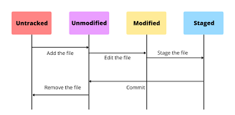
Status of a file/Repo:
“Untracked”: New files that git doesn't yet track. “Modified”: Changed/Changes made in file. “Staged”: Files ready to be committed. “Unmodified”: Unchanged.

Slide 32

Untracked Files/repo
Definition: Untracked files are files in your working directory that Git is not currently managing.
Status: These files have never been committed, and Git is not aware of their existence.
Git Command: To start tracking an untracked file, you use git add <file> to stage it, followed by a commit.

Slide 33

Unmodified
Definition: Unmodified files are files that have not been changed since the last commit.
Status: Git is aware of these files, but there are no new changes to be committed.
Git Command: No specific command needed for unmodified files. They are already part of the last commit.

Slide 34

Modified files
Definition: Modified files are files that have been changed in your working directory since the last commit.
Status: Git is aware of the changes, but these changes are not yet staged for the next commit.
Git Command: Use git add <file> to stage the modified file for the next commit.

Slide 35

Staged
Definition: Staged files are files that have been marked to be included in the next commit.
Status: These files have been modified, and their changes are in the staging area, ready to be committed.
Git Command: After modifying a file, use git add <file> to stage the changes.

Slide 36
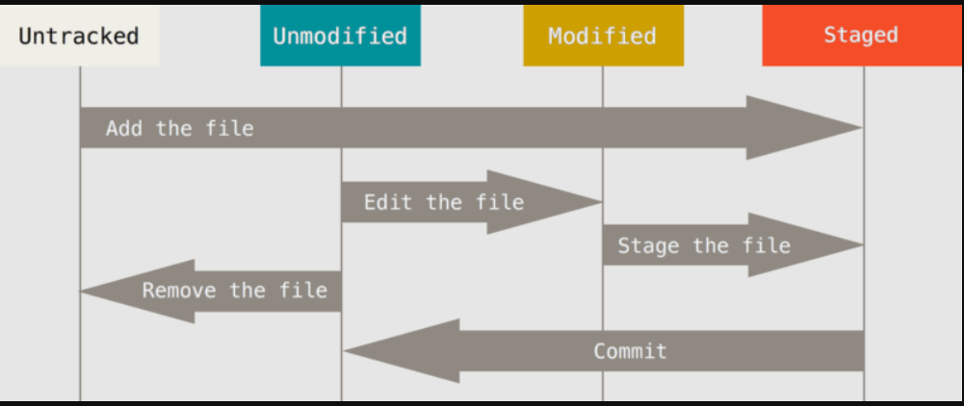

Slide 37
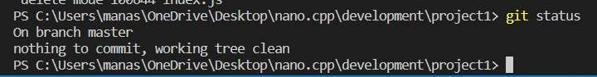
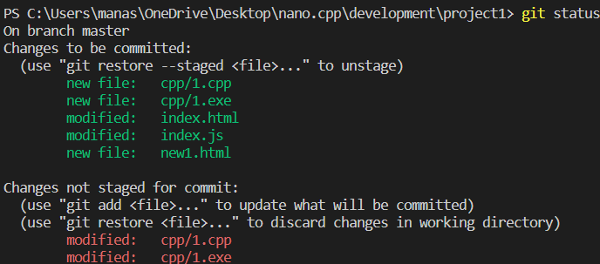



Slide 38
Git Status
“git status” is a Git command that displays the current state of your local Git repository, showing which files have been modified, added, or deleted, and their status in relation to the last commit. It helps you track changes before committing them.
syntax: git status

Slide 39


How Git Tracks:
add: Moves changes from the working directory to the staging area. This gives you the opportunity to prepare a snapshot before committing it to the official history.
syntax: git add <file name>
git add . -> to add all the files to staging area.

Slide 40
commit
Takes the staged snapshot and commits it to the project history. Combined with git add, this defines the basic workflow for all Git users.
Syntax: git commit -m "Add new features and update existing code"

Slide 41
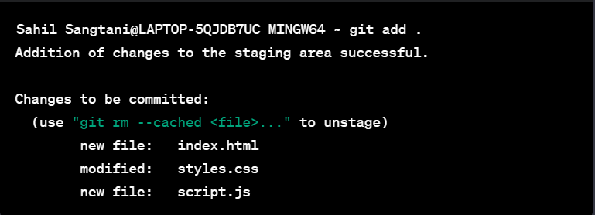


Slide 42
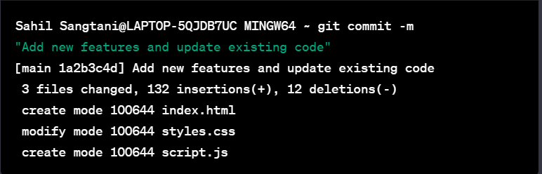

Slide 43




Push:
Used to upload repo content to remote (on github ).
The "push" command in Git, commonly used with platforms like GitHub, is the process of uploading your local code changes to a remote repository. It synchronizes your local commits with the remote repository, allowing collaboration and sharing of code changes with others working on the same project.
syntax: git push origin main.

Slide 44
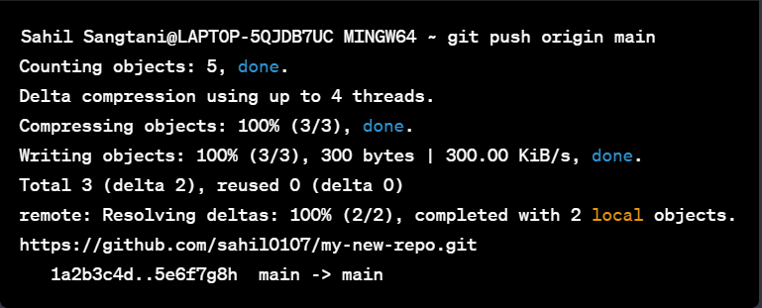
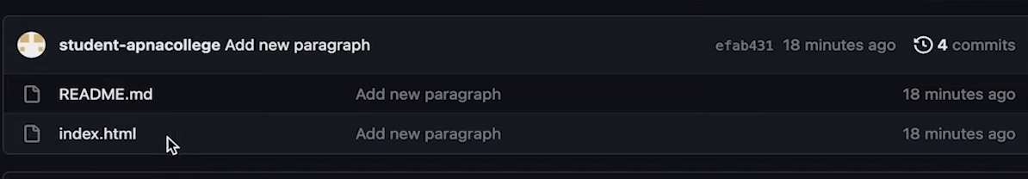


Slide 45
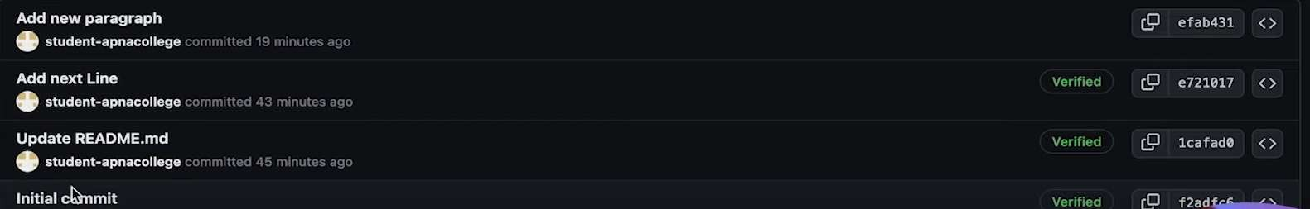




How it tracks and history:

Slide 46



What we have done till now: Created a new repository on github Cloned it to VS Code
Made changes in repo and then added and committed. Again pushed back that repo to github.

Slide 47
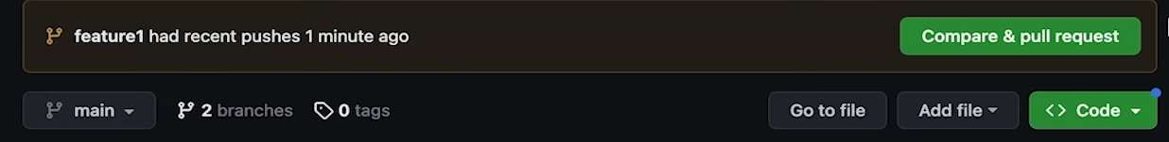

Pull request:
A "pull request" (PR) is a feature on platforms like GitHub where you propose code changes to a repository. Others review, discuss, and potentially merge your changes into the main codebase. It facilitates collaboration and quality control.
syntax: git pull origin main

Slide 48
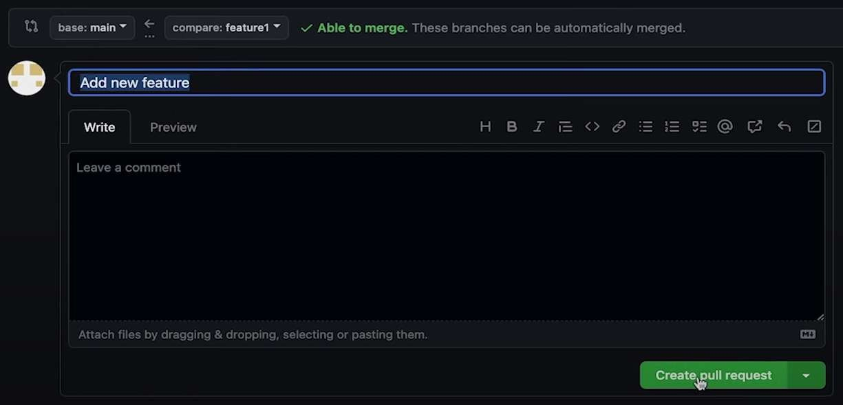

Slide 49
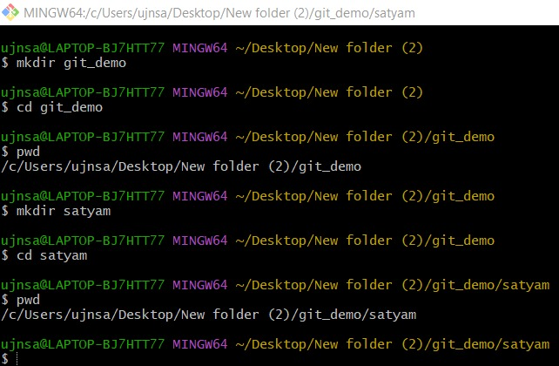
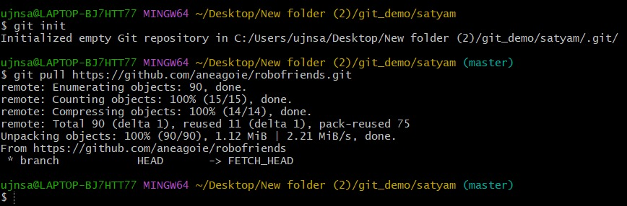

Slide 50
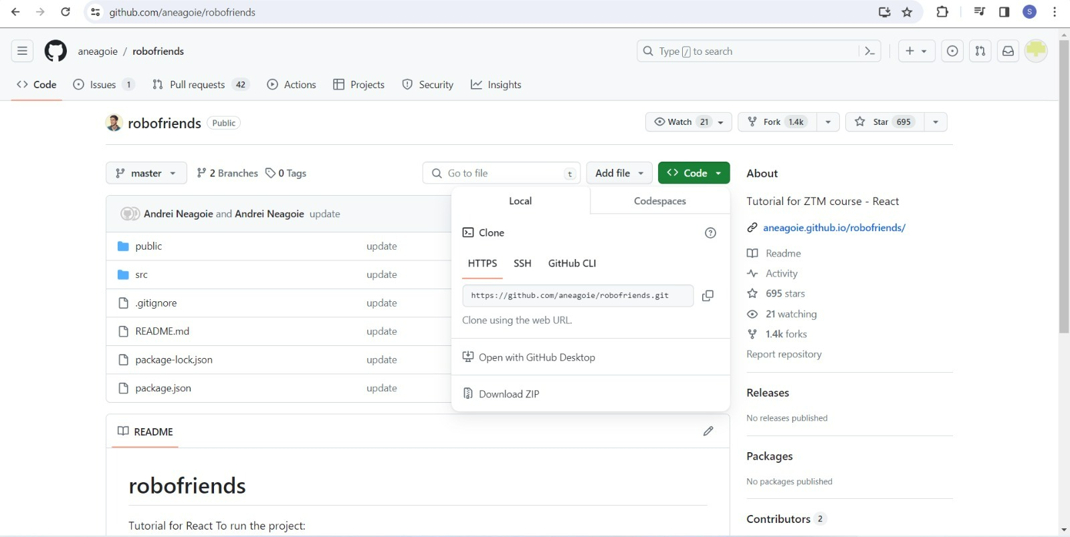

Slide 51
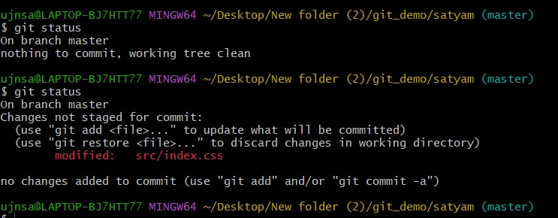
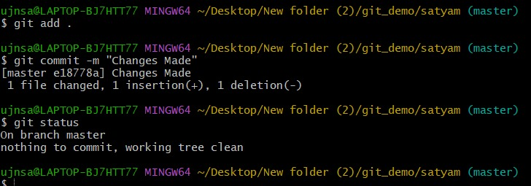

Slide 52
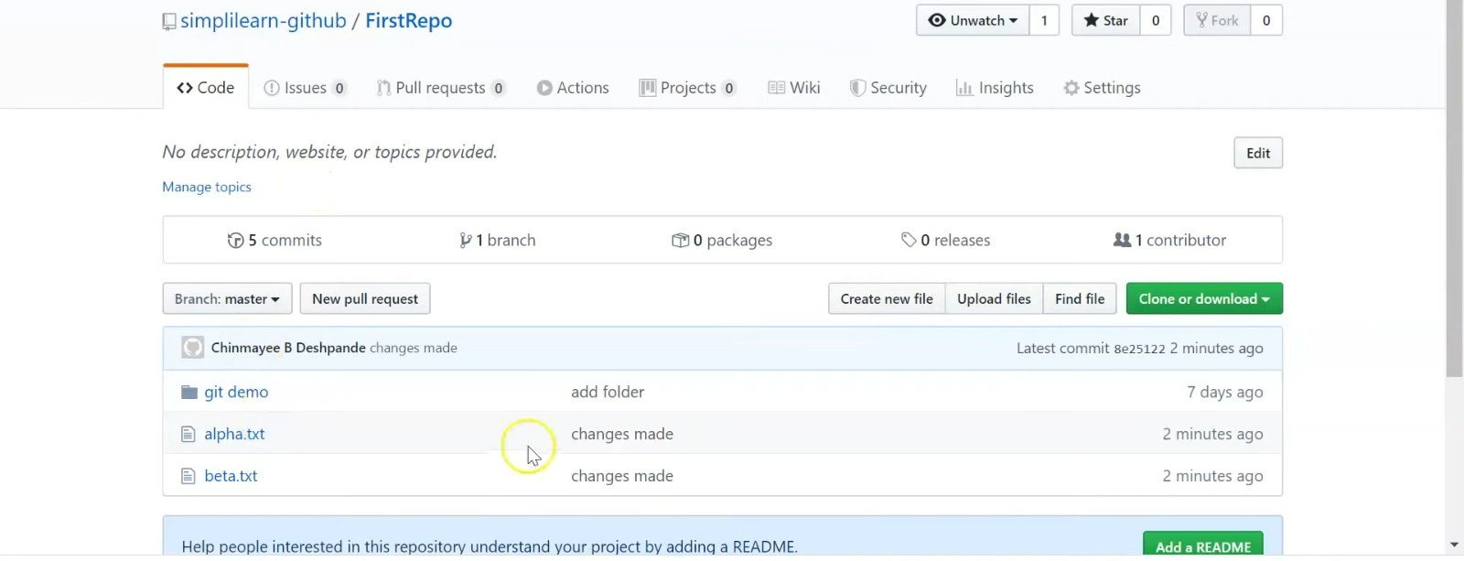

Slide 53
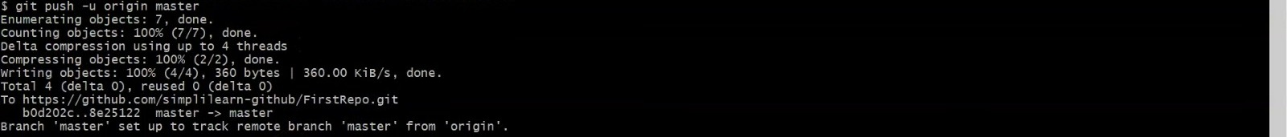

Slide 54
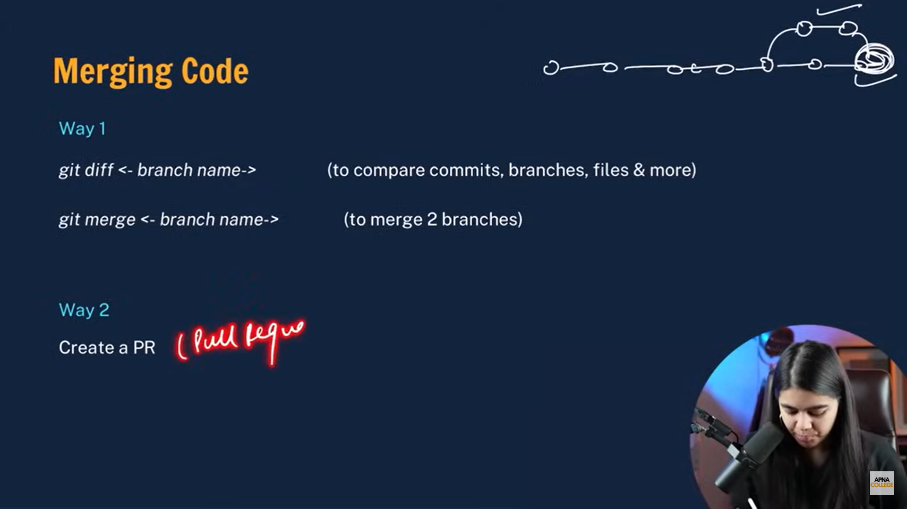


Slide 55
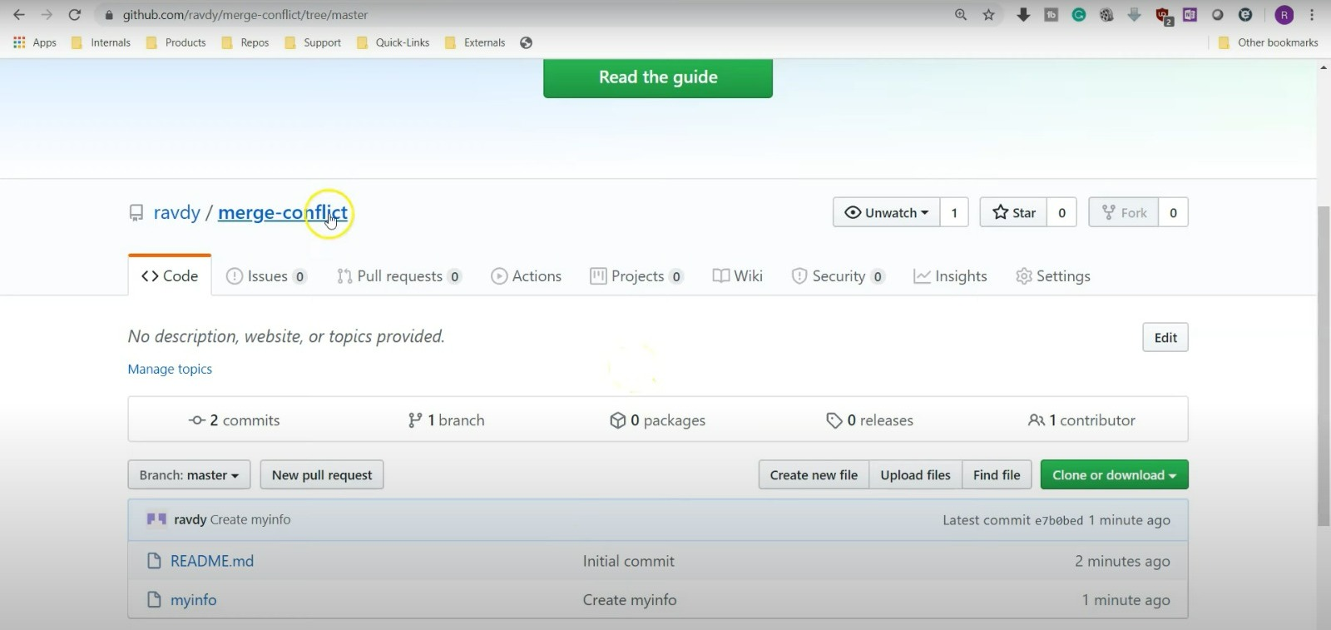

Slide 56
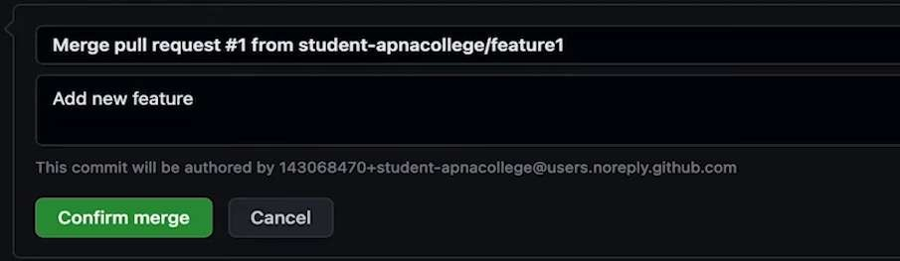
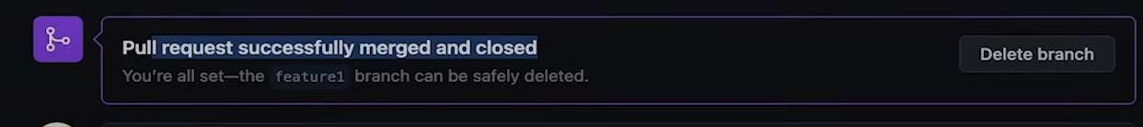

Slide 57
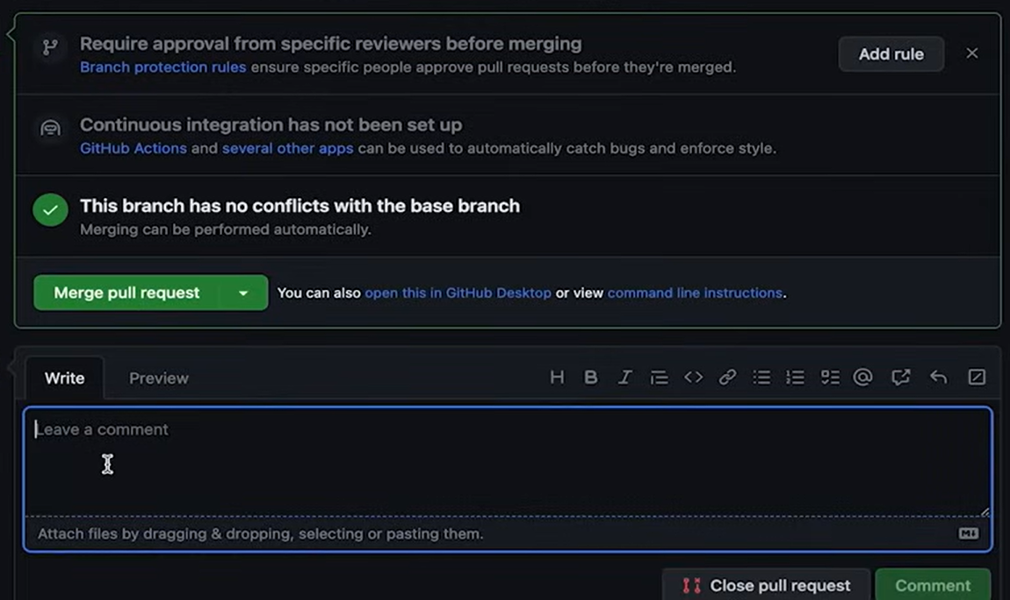

Slide 58
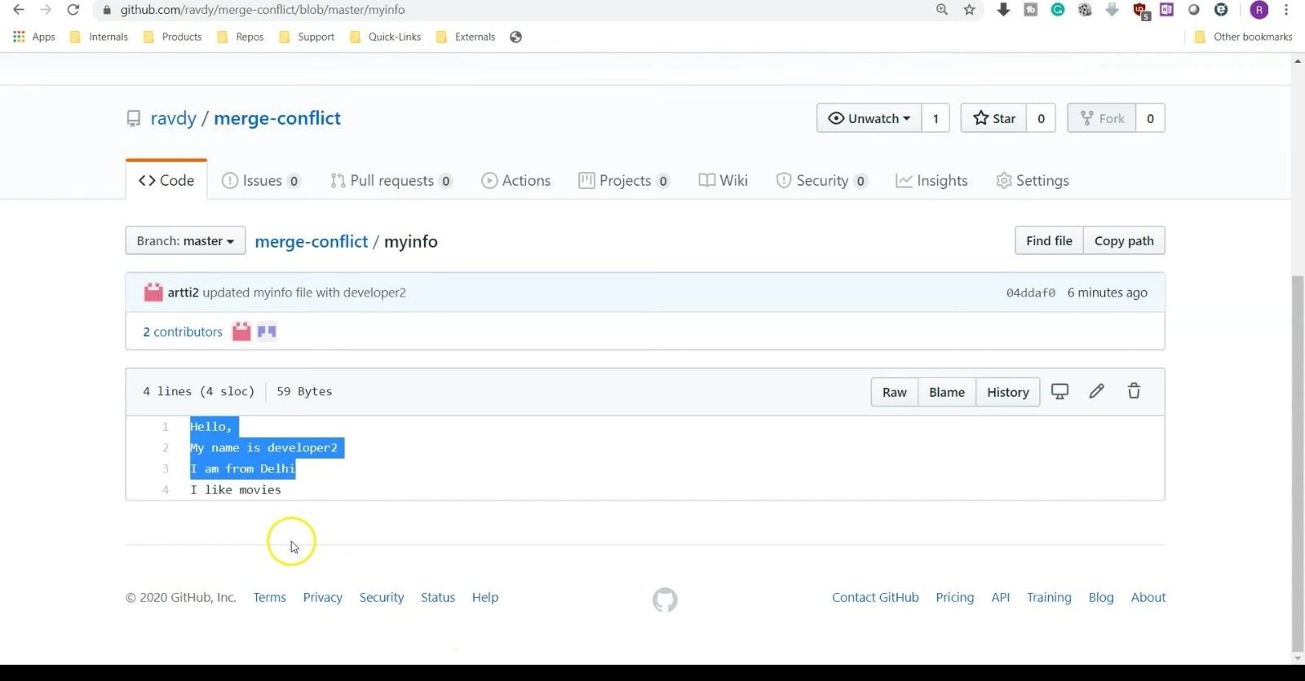

Slide 59
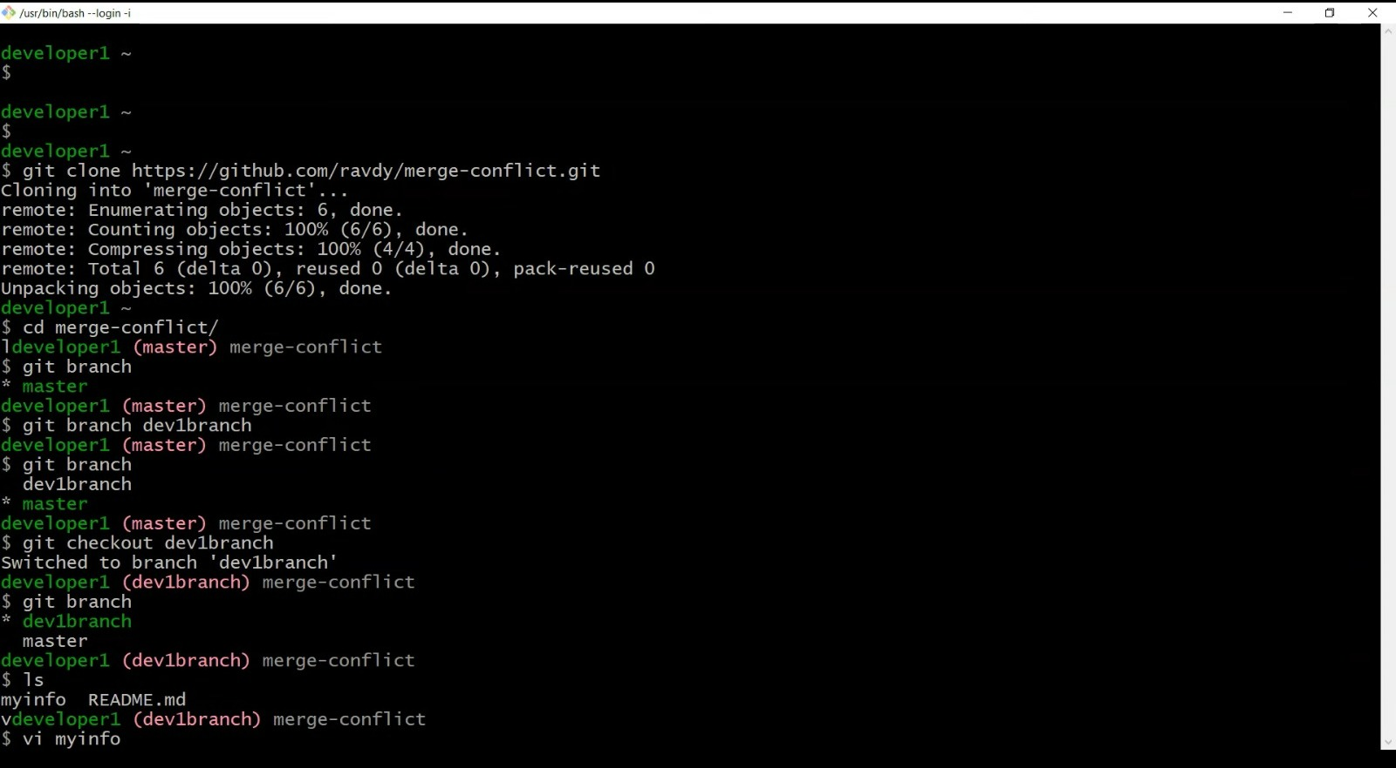

Slide 60


Slide 61


Slide 62


Slide 63


Slide 64



Slide 65

Resolving Merge conflicts:
An event that takes place when git is unable to automatically resolve differences in code between two commits.
syntax: git merge <file_name>

Slide 66


Slide 67




Fork:
The "fork" command in Git, typically used in platforms like GitHub, creates a personal copy of a repository, allowing you to make independent changes without affecting the original project.
Fork is like a rough copy

Slide 68


Slide 69


Slide 70


Slide 71


Slide 72


Slide 73


Deleting Repo:
To delete a repository on GitHub:
Go to the repository's main page.
Click "Settings" on the right.
Scroll down to the "Danger Zone" section.
Click "Delete this repository."
Confirm the repository name.
Click "I understand the consequences, delete this repository." Please be cautious as this action is irreversible, and all data associated with the repository will be permanently deleted.

Slide 74




Slide 75


Slide 76


Slide 77


Slide 78
How to upload files/folders/projects on GitHub using GitBash?
So far we have seen what is Git, GitHub and git commands. Now it’s time to finally implement this knowledge and upload our project, files or folders to GitHub repository using gitbash. Just follow along the procedure mentioned ahead and you can easily get the job done.

Slide 79

1. Open the folder which ha your project files. Then shift+right click and a drop down menu would appear. Click on open with Git Bash.

Slide 80

2. In the terminal enter the command git status. Since the the repository is not yet initialized, we use the git init command.

Slide 81



3. Now you need to tell Git about your files by adding them to your repository. Do this with git add filename. If you want to add all your files, you can do git add .

Slide 82


4. Now that you have added your files and made your changes, you need to commit your changes so Git can track them. Type git commit -m "adding files". -m lets you add the commit message in line.

Slide 83

So far, the above steps is what you would do even if you were not using GitHub. They are the normal steps to start a Git repository. Remember that Git is distributed (decentralized), meaning you don't need to have a "central server" (or even a network connection), to use Git.
Now you want to push the changes to your Git repository hosted with GitHub.

Slide 84

5. To push the changes to your Git repository hosted with GitHub. You do this by telling Git to add a remote location, and you do that with this command:
git remote add origin https://github.com/yourusername/your-repo- name.git

Slide 85




6. Once you have done that, Git now knows about your remote repository. You can then tell it to push (which is "upload") your committed files:
git push -u origin master

Slide 86

You can check the pushed files/folders by visiting the repositories on your GitHub account.

Slide 87






THANK YOU!

